Slide 1
Deep Learning APPLICATIONS In Medical Image Analysis
JOSE DIXON – CS470 – AI – FALL 2018
JUSTIN KER1, LIPO WANG 2, JAI RAO1, AND TCHOYOSON LIM3
1Department of Neurosurgery, National Neuroscience Institute, 308433 Singapore
2School of Electrical and Electronic Engineering, Nanyang Technological University, 639798 Singapore
3Department of Neuroradiology, National Neuroscience Institute, 308433 Singapore

Slide 2
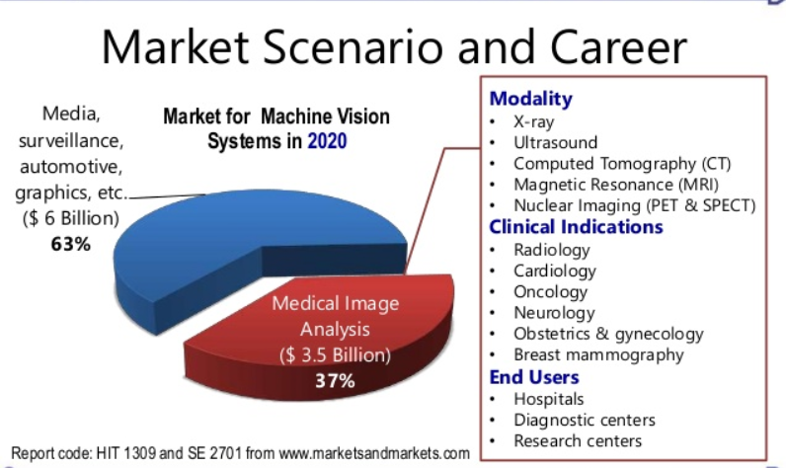
Purpose and Objective: Medical Image Analysis
Increased use of electronic records leads to Machine learning algorithms and image recognition tasks becoming more successful.
Machine learning can discover data algorithmically without laborious hand-crafting of features.
Machine learning algorithms can help improve effectiveness and aid in decision making for doctors, patients and physicians for medical imaging.
Medical image analysis is a key area in medical image computing and machine learning. Scientific methods are used for solving problems pertaining to images and their use for biomedical research and healthcare.

Slide 3
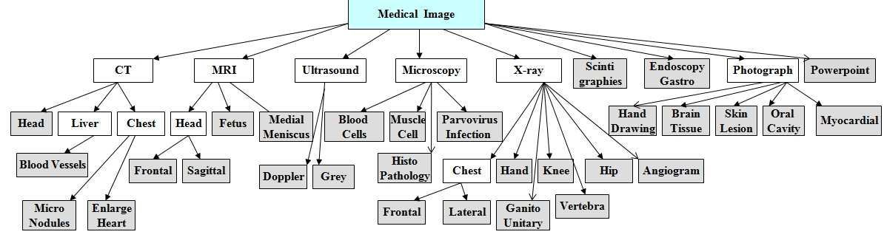
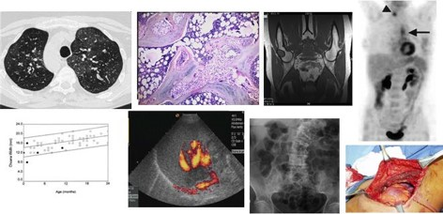
Types: Medical Imaging and Modalities
Some of these modalities examine multiple organs (such as CT, MRI) while others are organ speciﬁc (retinal photography, dermoscopy).
The amount of data generated from each study or image also varies.
A histology slide is an image ﬁle of a few megabytes while a single MRI may be a few hundred megabytes.

Slide 4
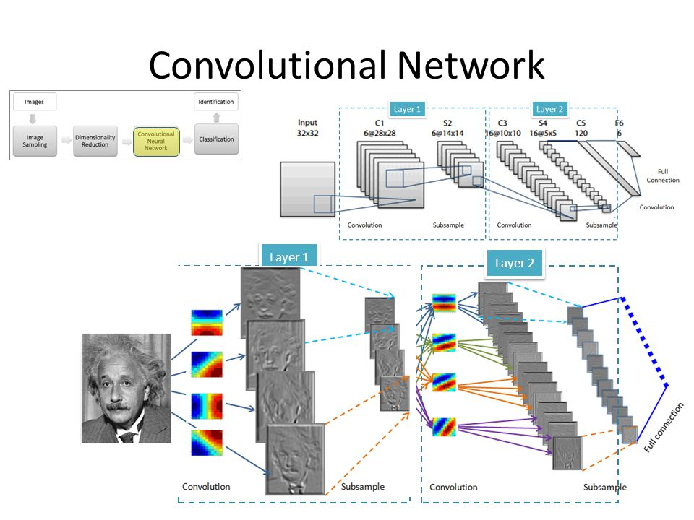
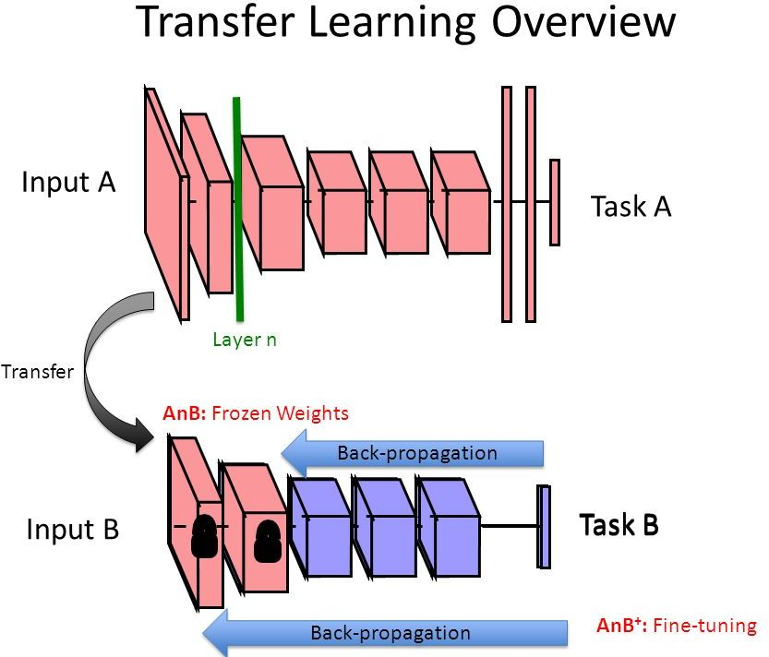
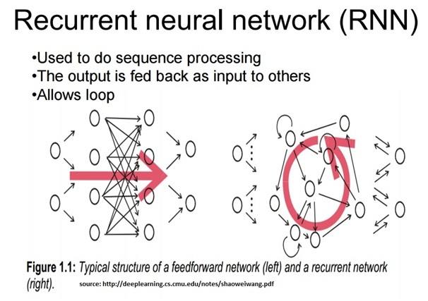
Supervised ML Architectures: CNNs, Transfer Learning, RNNs
Supervised learning = input variables (X) + an output variable (Y) + algorithm for mapping function from input to the output.
The goal is to approximate the mapping function so well for new input data (x) predicting output variables (Y)
Three supervised ML models:
Convolutional neural network: takes an input image of raw pixels, and transforms it via Convolutional Layers, Rectiﬁed Linear Unit (RELU) Layers, Pooling Layers, Fully Convolutional layers..
Transfer Learning with CNNs: is a machine learning method where a model developed for a task is reused as the starting point for a model on a second task.
Recurrent Neural Network: They are networks with loops in them, allowing information from the input to persist.

Slide 5
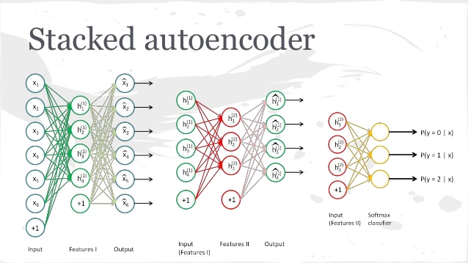
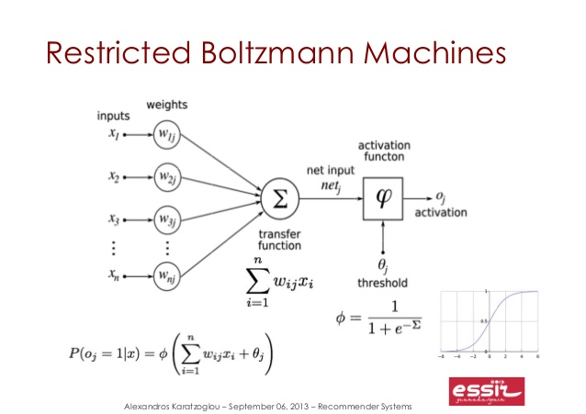
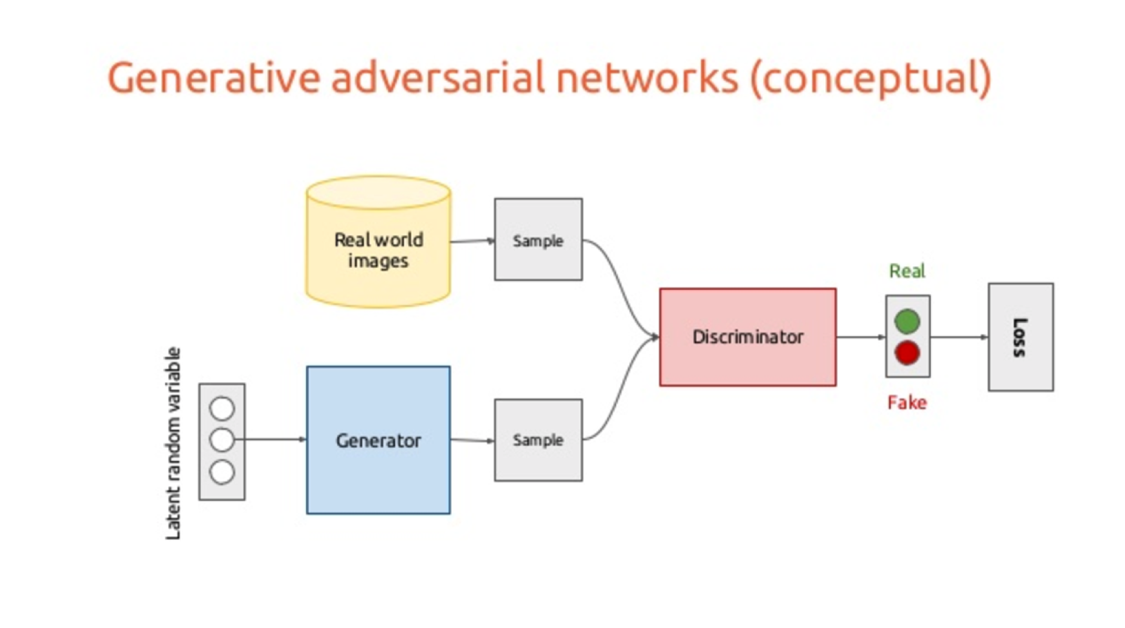
Unsupervised ML Architectures: Autoencoders, RBMs, GANs, and DBNs
Unsupervised learning is where you only have input data (X) and no corresponding output variables.
The goal for unsupervised learning is to model the underlying structure or distribution in the data in order to learn more about the data.
Three unsupervised ML models:
Autoencoders: learn feature representations of input data (called codings) in an unsupervised manner without labelled data—different types: Stacked, Denoising, Sparse, Variational.
Restricted Boltzmann Machines: is a generative stochastic artificial neural network that can learn a probability distribution over its set of inputs. Deep Belief Networks, variation of RBM--hidden layer output is input for the visible layer of a second RBM stacked on it.
Generative Adversarial Networks: comprise of two simultaneously-trained, competing models, which may be multilayer perceptrons such as CNNs.

Slide 6
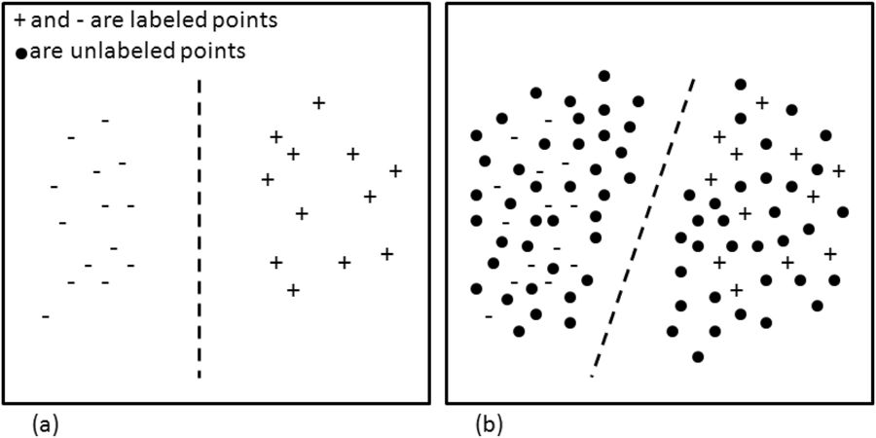
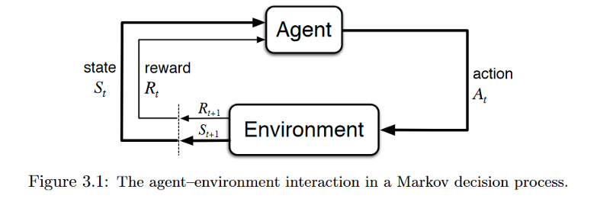
Other ML Architectures: Semi-supervised and Reinforcement ML Models
Semi-supervised ML: Problems where you have a large amount of input data (X) and only some of the data is labeled (Y) are called semi-supervised learning problems.
To make best guess predictions for the unlabeled data, feed that data back into the supervised learning algorithm as training data and use the model to make predictions on new unseen data.
Reinforcement learning: is the field that studies the problems and techniques that try to retro-feed it’s model in order to improve.
It actually relies on being able to monitor the response of the actions taken, and measure against a definition of a “reward”.

Slide 7
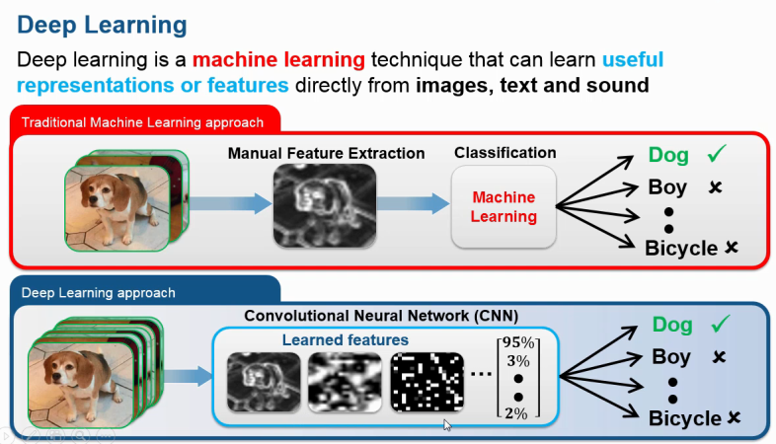
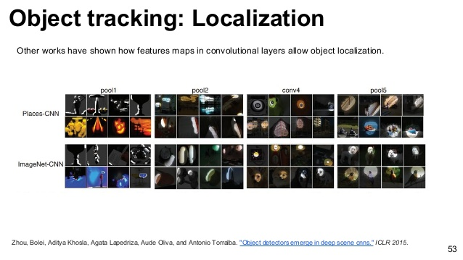
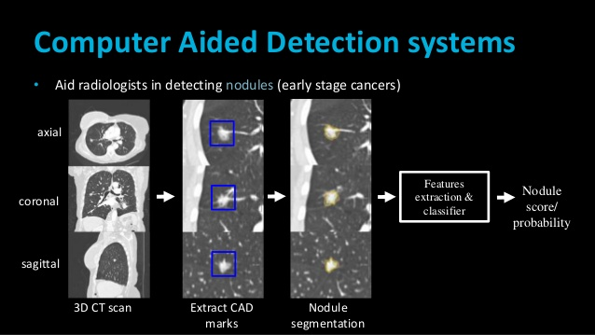
Applications in Medical Image Analysis: Classification, Localization, and Detection
First three applications in medical image analysis are:
Classification: Computer-aided diagnosis (CADx) is to improve the diagnostic accuracy and the consistency of the radiologists’ image interpretation and second opinion.
Localization: Object localization aims to locate and predict the main (or most visible) object in an image and tries to find out all the objects and their boundaries.
Detection: Computer aided detection (CADe) is a technology designed to decrease observational oversights—and thus the false negative rates—of physicians interpreting medical images.
Machine learning classifiers (Support Vector Machine, Random Forest) and feature extractors (Local Binary Patterns, Bag of Visual Words), convolutional neural networks (VGG, ResNet) are used possibly, with techniques such as data augmentation and stacked autoencoders.

Slide 8
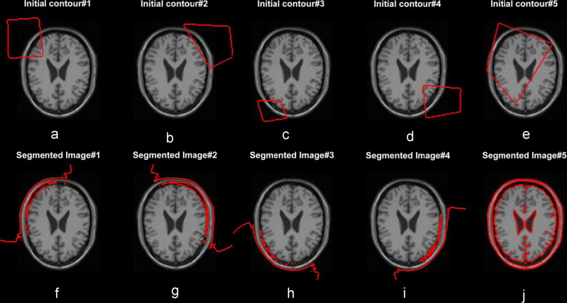
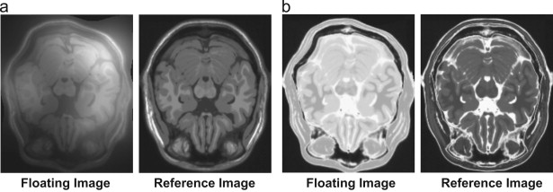
Applications in Medical Image Analysis: Segmentation and Registration
Last two applications in medical image analysis are:
Segmentation: Image Segmentation means creating parts of an image into segments which are conceptually meaningful or simple for further analysis. Usually we want to locate objects and boundaries in the images.
Registration: Image registration is the process of overlaying images (two or more) of the same scene taken at different times, from different viewpoints, and/or by different sensors.
This is relevant to two or three-dimensional convolutional neural network architectures and primarily used for CT and MRI scans.

Slide 9
Conclusion: Future Work and Challenges Medical Image Analysis
Challenges in medical image analysis:
Limit imposed by the lack of labelled datasets, which hampers training and task performance.
The lack of data is two-fold and more acute: there is general lack of publicly available data, and high-quality labelled data is even more scarce.
Data or class imbalance in the training set refers to the number of images in the training data being skewed towards normal and non-pathological images
Future work and research of medical image analysis include prognostication, content-based image retrieval, image report or caption generation, and manipulation of physical objects with LSTMs and reinforcement learning, involving surgical robots.

Slide 10
Closing Video
https://www.youtube.com/watc h?v=mvovHJDnDLA (Crtl+Click, Copy and Paste)

Slide 11
References
“A Gentle Introduction to Transfer Learning for Deep Learning.” Machine Learning Mastery, 21 Dec. 2017, machinelearningmastery.com/transfer-learning-for-deep-learning/.
Banerjee, Suvro. “An Introduction to Recurrent Neural Networks – Explore Artificial Intelligence – Medium.” Medium, Medium, 23 May 2018, medium.com/explore-artificial-intelligence/an-introduction-to-recurrent-neural-networks-72c97bf0912.
“Medical Image Analysis-The Wave of Future Diagnosis.” Edocscan.com, www.edocscan.com/medical-image-analysis.
Machado, Gustavo. “ML Basics: Supervised, Unsupervised and Reinforcement Learning.” Medium, Medium, 6 Oct. 2016, medium.com/@machadogj/ml-basics-supervised-unsupervised-and-reinforcement-learning-b18108487c5a.
“ML Wiki.” Cosine Similarity - ML Wiki, mlwiki.org/index.php/Semi-Supervised_Clustering.
Supervised and Unsupervised Machine Learning Algorithms.” Machine Learning Mastery, 22 Sept. 2016, machinelearningmastery.com/supervised-and-unsupervised-machine-learning-algorithms/.

Slide 12
Other ML Architectures: Semi-supervised and Reinforcement ML Models
Problems where you have a large amount of input data (X) and only some of the data is labeled (Y) are called semi-supervised learning problems.
You can also use semi-supervised learning techniques to make best guess predictions for the unlabeled data, feed that data back into the supervised learning algorithm as training data and use the model to make predictions on new unseen data.
Reinforcement learning is the field that studies the problems and techniques that try to retro-feed it’s model in order to improve.
It actually relies on being able to monitor the response of the actions taken, and measure against a definition of a “reward”.
Reinforcement ML
Semi-supervised ML

Slide 13
ML Architectures: Supervised ML Features

Slide 14
Objective: Medical Image Analysis
Machine learning algorithms can help improve effectiveness and aid in decision making for doctors and physicians for medical imaging.
The increase access to health care for people has attributed to increase expenses for medical staff to perform medical imaging tasks manually at medical facilities. .
Medical image analysis is an active ﬁeld of research for machine learning, partly because the data is organized and patients can be evaluated the data from artificial intelligence systems.
Medical image analysis is closely associated with medical image computing. Medical image computing uses computational and mathematical methods for solving problems pertaining to medical images and their use for biomedical research and clinical care.

Slide 15
Types: General Machine Learning Techniques
Supervised learning:
Semi-supervised learning:
Unsupervised learning:
Reinforcement learning:

Slide 16
Algorithm Approaches: Machine Learning vs Deep Learning
Machine learning: Input image + Feature extraction algorithms (Color Histogram, Histogram of Oriented Objects, Local Binary Patterns) + ML Classifiers (Support Vector Machine, Random Forest)
Deep learning: Input image + Convolutional Neural Network architectures (Feature extraction & Classification – VGGNet, ResNet, GoogleNet, Xception)

Slide 18
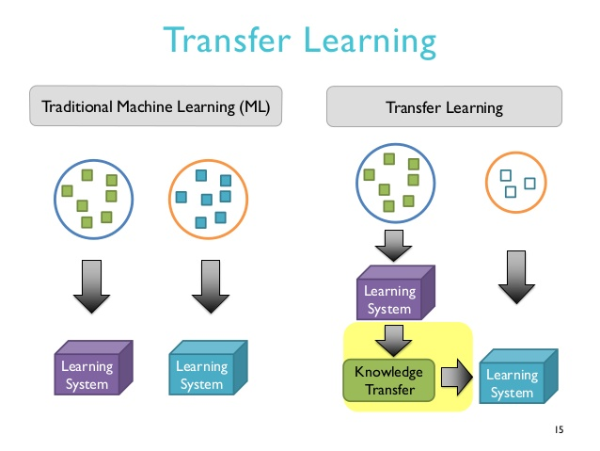
Supervised ML: Transfer Learning with CNNs
Transfer learning is a machine learning method where a model developed for a task is reused as the starting point for a model on a second task.
Transfer learning is related to problems such as multi-task learning and concept drift and is not exclusively an area of study for deep learning.
Transfer learning is an optimization that allows rapid progress or improved performance when modeling the second task.
Transfer learning is closely associated with deep learning and feature extraction.

Slide 19
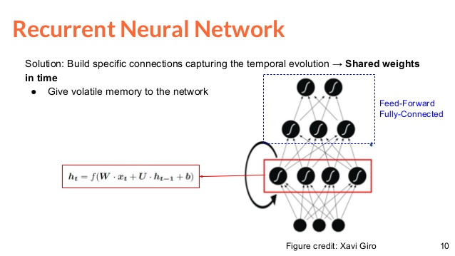
Supervised ML: Recurrent Neural Networks

Slide 20
Unsupervised ML: Autoencoders
Autoencoders learn feature representations of input data (called codings) in an unsupervised manner without labelled data.
Stacked autoencoders (SAEs) have a typically symmetrical architecture, with a line of reﬂection through the middle = hidden layer.
Denoising Autoencoder reported by Vincent et al. [32], where Gaussian noise is added to the early hidden layers
Sparse Autoencoders [33], whereby a deﬁned proportion of the neurons in the hidden layers are deactivated or set to zero.
Variational Autoencoders are a generative model, consisting of a Bayesian inference encoder network and a decoder network, that can be trained with stochastic gradient descent.

Slide 22
Machine Learning Architectures: Unsupervised Machine Learning Models
Unsupervised Machine Learning Models are Autoencoders, Restricted Boltzmann Machines, and Generative Adversarial Networks

Slide 23
Applications in Medical Image Analysis

Slide 24
Semi-supervised
Reinforcement

Slide 25
Challenges in Medical Image Analysis

Slide 26
Future Challenges in Medical Image Analysis

